Slide 1


ATM-Simulator Project
Presented by -Prakhar Goyal
SAP ID:590027648
Batch-59
Semester-1
Course Name-Programming In C
SOCS,UPES

Slide 2
Introduction:
This project on Automated Teller Machine(ATM) is made using C Programming language.
This is a simulation of real ATM,it allows a single user to
perform various everyday needed operations like ,logging in
via a pin(with max 3 wrong attempts for Security
feature),checking account balance,depositng and
withdrawing money,changing atm pin,changing
username,prinntng receipt and mini transaction history (on
screen) using file handling concepts.
2

Slide 3
Objectives
  To build a simple and easy to use ATM Simulator in C that feels similar to a real ATM experience.
  To apply the concepts taught by our professor in the semester
  To allow the user to perform everyday ATM operations tasks like logging in an ATM with secure PIN,checking current balance,deposit and withdraw money,change PIN,etc
  To use the concepts of file handling so the ATM can remember acc details even after the program is terminated.
  To use the concept of modular programming approach and breaking the code into clean and reusable functions that are easy to understand.
  To get a clearer idea how real ATM machine work behind the scene
  To implement a basic easy security mechanism (3 wrong PIN attempts) to make ATM feel more like real ATM.
  To improve my understanding and logic building by handling different types of user input cases.

Slide 4
Problem Definition
  In everyday life,ATM is used by people everyday but very few know what happens inside the machine’software, how it updates the account balance and info.
  There is a need to simulate how an ATM performs tasks like login,transactions and error handling
  The system must allow secure login using a 4 digit PIN with only 3 attempt allowed.
  It should support basic banking operations like checking balance,deposit and withdraw money,change PIN,username,Mini Transaction History.
  User data must be stored in a file using file handling .
  The system must handle invlalid inputs and maintain errorless operations
  The interface must be like real ATM

Slide 5
Solution Approach
  Used structure to store account details.
  The program loads saved account data using the function loadFromFile() and creates a default account if no file exists.
  Used a secure login system which verifies 4-digit with a limit of 3 attempts.
  After the user login,a menu driven system(with loop and switch case) allows the user to choose diferent ATM tasks and operations.
  Each operation is implemented by using modular functions approach like depositMoney(),withdrawMoney(),changePIN(),checkBalance(),etc.
  Files (account.txt and history.txt) are used to permanently store account and transction history even after the program termination implementing File Handling concepts.
  A reset function that is used to clear all data and restoring the details to a preset default values for testing and demonstration purposes.
  All inputs are validated (wrong PIN,invalid amounts and empty names and buffer cleaning) to check for smooth and error free execution .Buffer Cleaning using fgets() along with NULL,also used fgetc().

Slide 6
Algorithm of main() function
  Start the program
  Load the saved account data;if file not found it creates a default account
  Initialize attempt counter=0
  Loop until correct PIN entered by user or attempts =3
      Ask for 4 digit PIN
      Validate numeric input
      If PIN matches then show welcome and break
      else it increases attempts count and show attempts left
  If attempts reached 3 then show that Account locked and exit the program
  Loop until user selects Exit
    Read menu choice
    Call the required function
      checkBalance()
      depositMoney()
      iii.withdrawMoney()
      changePIN()
      showHistory()
      changeName()
      resetAccount()
    Handle invalid choices
  On exit show Thank You message
  End

Slide 7

Scope of The Project
  Simulates essential ATM functions for everyday banking
  Allows secure login using a PIN with limited attempts
  Supports balance check,deposit,withdrawal,PIN change,name update and reset account
  Provides a mini transaction feature
  Maintains data using file handling for storage
  Focusses on reusability of functions and understanding C programming concepts taught to us

Slide 8
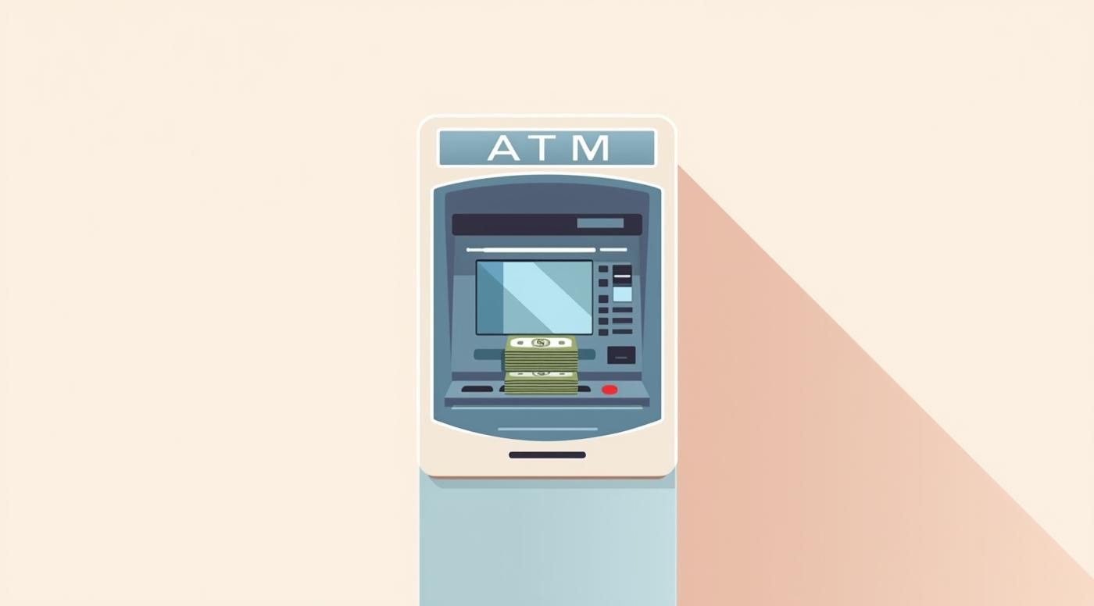
Major Functions Used
  checkBalance()-displays current account balance
  depositMoney() -adds money to balance and updates history
  withdrawMoney()-it deducts the amount and checks sufficient balance
  changePin()-updates PIN with confirmation
  changeName()-used to update account holder’s name
  showHistory()-to show mini transaction history
  saveToFile()-to save account data permanently to account.txt file
  loadFromFile()- to load the saved data and if not present it loads default values
  resetAccount()-clears data of account.txt & deletes all transactions and resets to default

Slide 9
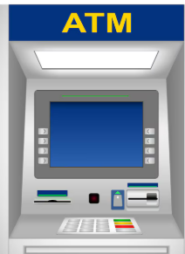
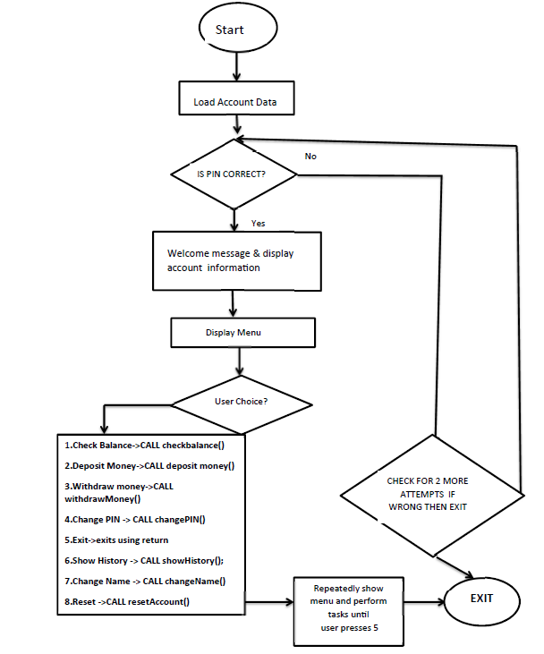
A short Flowchart of main( ) function

Slide 10
TESTING
Test Case | What I tested | What I expected to Happen | What Actually Happened | Result
1.Correct PIN Entry | PIN=correct value | Login successful | Login successful | Pass
2.Incorrect PIN Entry | PIN=wrong value (3 times) | Access Denied after 3 attempts | Access denied | Pass
3.Deposit Valid Amount | Deposit=500 | Balance increases by 500 | Balance updated correctly | Pass
4. Deposit Invalid Amount | Deposit=-50 or 0 | Show error message | Error shown | Pass
5.Withdraw Valid amount | Withdraw= amount<= balance | Balance reduced correctly | Works as expected | Pass
6.Withdraw More than Balance | Withdraw> balance | Show insufficient balance | Error Shown | Pass
7.Check Balance | Select balance option | Display current balance | Balance displayed | Pass
8.Change PIN(valid) | Enter new Valid PIN | PIN updated | PIN updated | Pass
9.Change PIN (invalid) | Entering mismatched pin in retyping pin | Should show error | Error message shown | Pass
10.Save Data to file | Select save option | File should be created/updated | File saved successfully | Pass
11.Load Data from file | Select Load option | Data should load correctly | Data loaded successfully | Pass
12.Mini Transaction History | Performing few operations | Should show last few transactions | Correct list displayed | Pass
13.Change account holder name | Entering a new valid name | Should update the name when a valid name is entered and save to file | Name updated to new name and saved in account.txt | Pass
14.Reset Account | Select Reset option | Balance and PIN reset to default | Reset successful | Pass
15.Exit | Selecting exit option from main menu | Program shouls terminate gracefully with a thank you message | Program exited successfully and displayed expected message | Pass

Slide 11
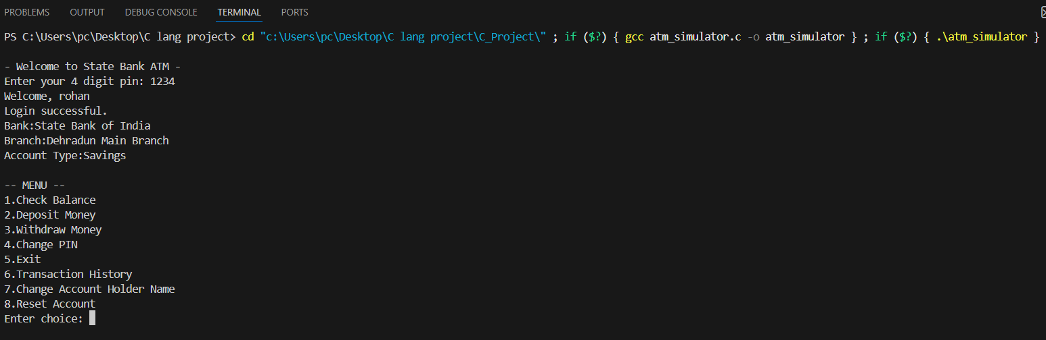
Some screenshots of the outputs (1)
Test case-1 screenshot : Correct PIN Entry
Explanation: The user entered the correct PIN .The system verified it successfully and displayed the welcome message along with account details.

Slide 12
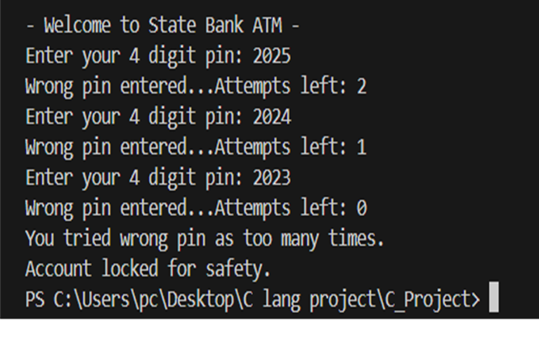
Some screenshots of the outputs (2)
Test case-2 screenshot : Incorrect PIN Entry
Explanation: The user entered an incorrect PIN three times. After the third attempt,the system denied access and displayed an account lock warning.

Slide 13
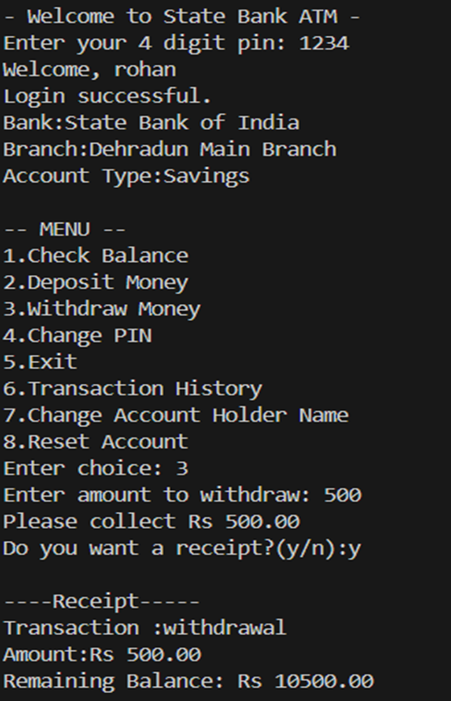
Some screenshots of the outputs (3)
Test case-5 screenshot : Withdraw Valid amount
Explanation:The user a valid amount within the available balance.The balance decreased accordingly and a receipt was optionally displayed.

Slide 14
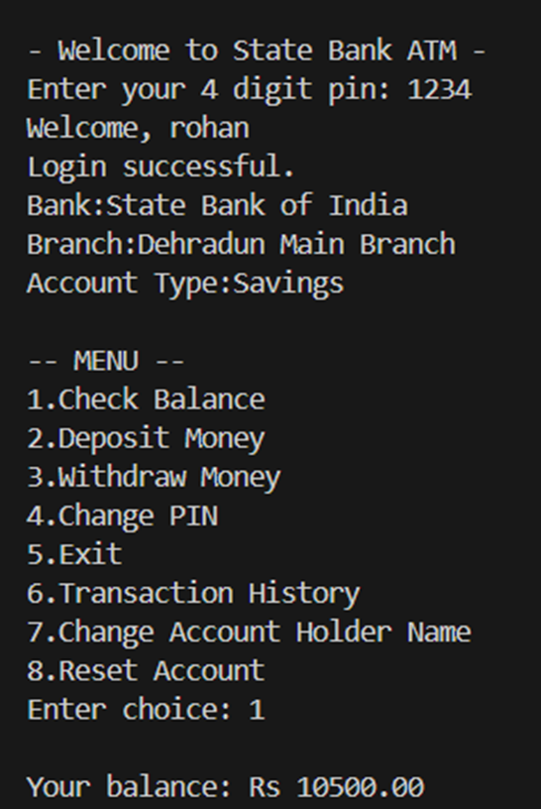
Some screenshots of the outputs (4)
Test case-7 screenshot : Check Balance
Explanation:The User selected the Check Balance option and the current was displayed correctly.

Slide 15
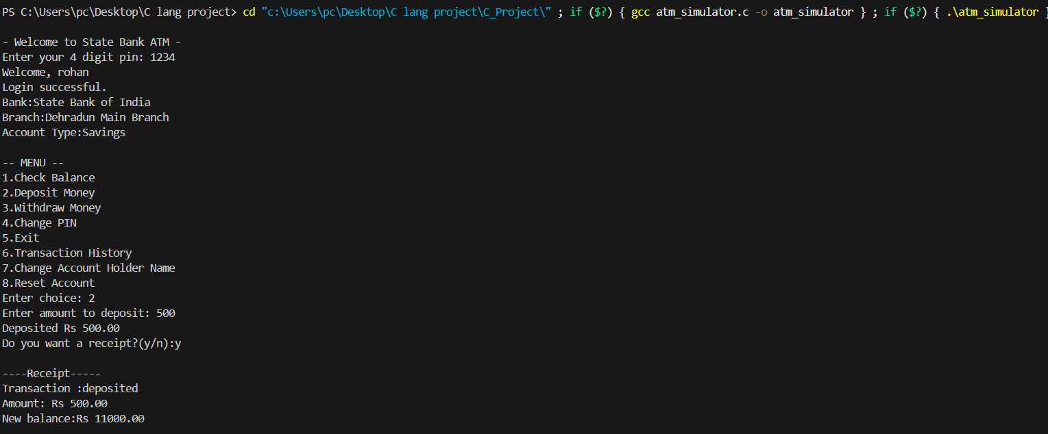
Working Code Demonstration
  Run ATM program live on VS code
  Key Functions to demostrate
    withdrawMoney() and DepositMoney()
    checkBalance(),resetAccount(),changePIN(),changeName()
    Login/PIN validation
  Input/Output behaviour

Slide 16
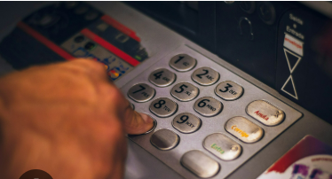
Novelty and Contributions
  I added a Reset Account feature that clears all the data and transaction history ,and put default values for easy testing.
  I also with help of file handling implemented a Mini Transaction History using history.txt,similar to a real ATM mini statement.
  I added an optional receipt printing for deposits and withdrawal to make it feel real life based.
  I used file handling so ATM remembers the user detail even after prog. terminates.
  I added strong input validation like invalid amount checks and PIN mismatching handling.
  Included low balance warnings on screen
  Used modular functions for clear and easy to understand code.

Slide 17

Conclusion
  This ATM simulator helped me understand real-world banking systems
  Breaking the program into reusable functions emphasized modular programming
  I implemented features:balance check,deposit/withdrawal,PIN change,mini transcation history,file handling and reset account
  Tried to apply all concepts
taught so far
  This project boosted my confidence and showed how programming solves real-life problems
  Thanks to our Professor Dr.Prashant Trivedi for his continuous guidance and support.

Slide 18

References:
  Let Us C Book by Yashavant Kanetkar
  Class materials and lecture notes provided by my Professor
  GeeksforGeeks

Slide 19
Appendix:code of some functions
void saveToFile(struct account acc)
{
FILE *fp = fopen("account.txt", "w");
if (fp == NULL)
{
printf("Error saving data!\n");
return;
}
//printing information to file account.txt
fprintf(fp, "%s\n%d\n%.2f\n%s\n%s\n%s\n",acc.name,acc.pin,acc.balance,acc.bankName,acc.branch,acc.type);
fclose(fp); //closing file
}
“All other test cases and full source code are available in the project report.”
void checkBalance(struct account acc)
{
printf("\nYour balance: Rs %.2f\n", acc.balance);//printing acc balance
if (acc.balance < 1000)
{ printf("\n WARNING:Your balance is very low.Please deposit soon.\n");
}
}

